Slide 1
DATA STRUCTURE : ARRAY
Mentor : Priya Bhatia

Slide 2
Introduction To Data Structure
Data Structure : Way of organizing the data so that the data can be used in an efficient way.
Every data structure is specialised or suited to different kinds of applications and do the specified task.
For example : B tree and B+ tree usually use for the implementation in databases and that’s why in our academics we study that topic in Database Management System in very detail.
Hash Tables usually used in implementation of Compilers to look up identifiers and that we usually study in Compiler Design in our academics.

Slide 3
Types of Data Structure
Linear : If the data elements forms a sequence or in a linear list.
Arrays
Linked List
Stack
Queues
Non Linear : If traversal of nodes is non linear in nature.
Graphs
Trees

Slide 4







Introduction To Array Data Structure
Arrays are the collection of similar types of data stored at contiguous memory locations. In this data structure, we can randomly access the element by using its index number.
Types of array :
Single Dimensional Array
Multi Dimensional Array

Slide 5





1D Array

Slide 6



Address of an element in an array

Slide 7




Slide 8







2D Array

Slide 9



Types of 2D Array
Row Major Form
Column Major Form

Slide 10








Address of an element in 2D array

Slide 11










Slide 12










Slide 13

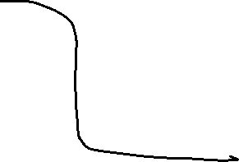



Slide 14





